Slide 1
Voice Controlled Object detection with NAO

Slide 2

Idea
Scan the room for an object with a certain color based on a voice command
Locate and move to an object using voice commands
Basic mobility voice commands such as moving and turning in any direction.

Slide 3

Voice Commands
Current methods in NAO ( ALSpeechRecognition )
Working with Webots and its limitations
Investigating other options
Python SpeechRecognition Module?
Snowboy
Picovoice

Slide 4

Object Detection
Camera Object in Webots
Distance and Angle Calculation
Utilizing Camera coordinates for Navigation
Getting the Object in the center of the camera

Slide 5

Implementation (Voice)
Hotword detection (Hey, Neo)
ML model for commands interpretation

Slide 6
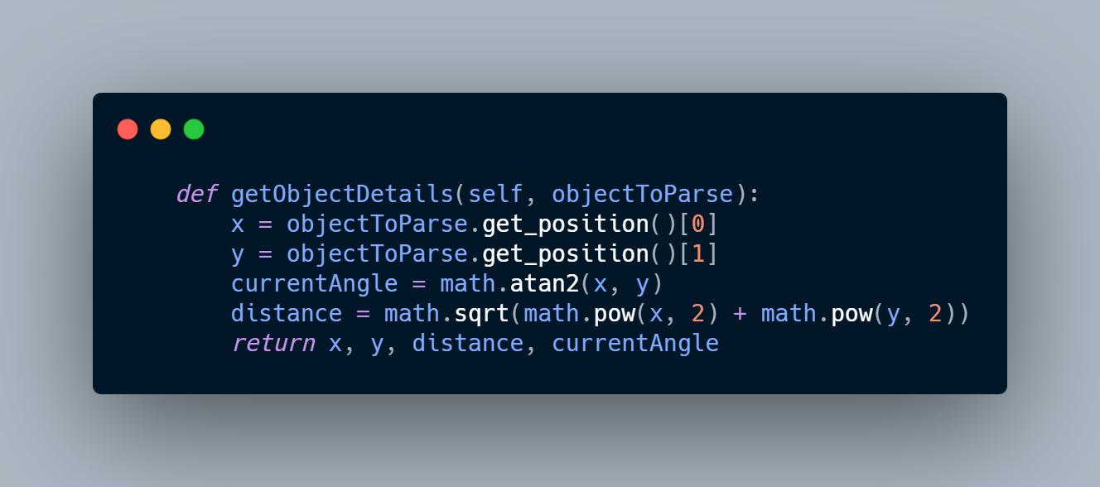
Implementation (Object Detection)

Slide 7

Implementation (Object Detection)
Angle will be negative
Angle will be positive

Slide 8
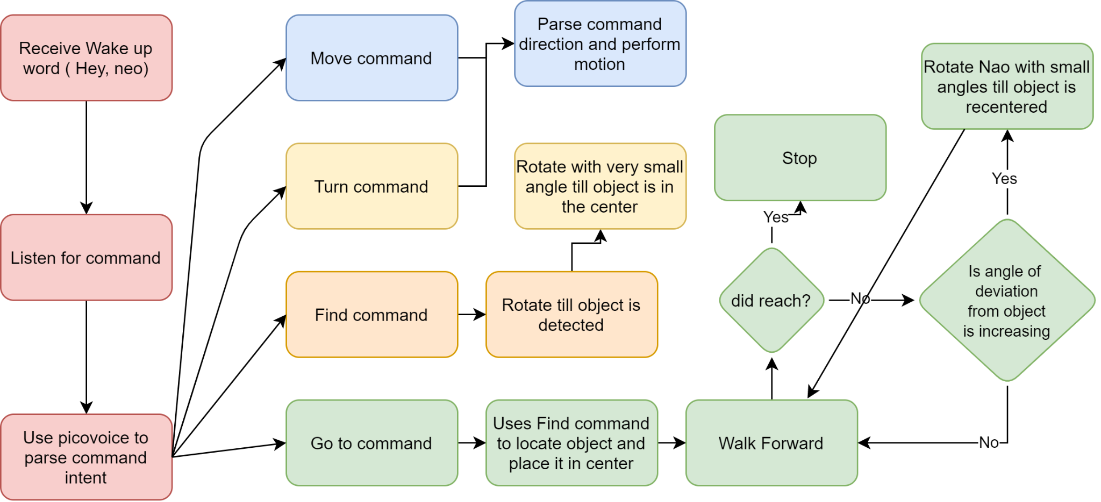
Flow

